Slide 1
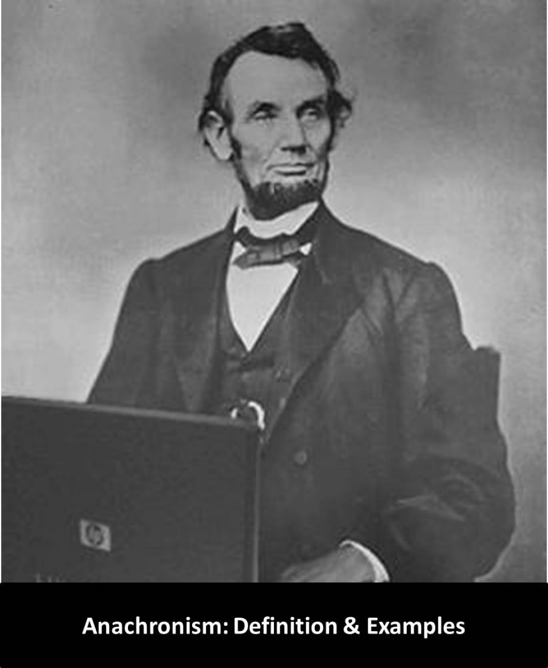
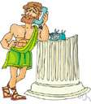
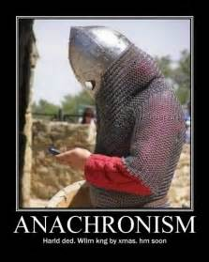
Welcome to Shenley’s History Department
Learning Objectives
Learn the key terms that historians use to describe and order time.
Apply your knowledge to order events and individuals into time-order.
Starter Task
Can you spot what is wrong with these pictures? Jot down your answers on a piece of paper or on a word document
Key terms
Historian: –A person who studies the events of the past, usually by working with written sources, objects and paintings left behind.
Chronological: Organised in the order in which they occurred.

Slide 2

How did you do? Did you notice that the pictures were showing people from the past with items that were not around when they were?
This is called an anachronism, something or someone that is out of their correct historical time. So, for example, a picture of a Roman soldier with a rifle or a telephone would be an anachronism, and so would Abraham Lincoln using a laptop to write with.
Landline telephones were not around in the Roman period
Laptops had not been invented in the 19th Century
A Viking with a mobile phone? Definitely not!

Slide 3
What is chronology?
A lot of events happened in the past. To write about them, historians need to organise them. One of the ways they do this is to place events in chronological order. The table below shows some of the terms historians use as part of this process. The problem is the definitions have all been jumbled up. Draw a line to link each term to the correct definition
BC | A label used by historians to identify the time between two dates in history. For example the, Tudor, Victorian or medieval periods.
AD | Before Christ. Used to indicate the year counting backwards from the birth of Jesus Christ. For example 500BC is 500 years before Christ was born. It is also know as Before the Common Era (BCE)
Period | Similar to a time-period, but usually with a larger date range. Examples include the Stone, Bronze and Iron Ages
Era/Age | Anno Domini (Latin meaning ‘in the year of the Lord’). Used to indicate the year counting forwards from the birth of Christ. For example, AD 500 is 500 years after Christ was born. It is also known as the Common Era (CE)

Slide 4
What is chronology?
How did you do?
BC | A label used by historians to identify the time between two dates in history. For example the, Tudor, Victorian or medieval periods.
AD | Before Christ. Used to indicate the year counting backwards from the birth of Jesus Christ. For example 500BC is 500 years before Christ was born. It is also know as Before the Common Era (BCE)
Period | Similar to a time-period, but usually with a larger date range. Examples include the Stone, Bronze and Iron Ages
Era/Age | Anno Domini (Latin meaning ‘in the year of the Lord’). Used to indicate the year counting forwards from the birth of Christ. For example, AD 500 is 500 years after Christ was born. It is also known as the Common Era (CE)

Slide 5
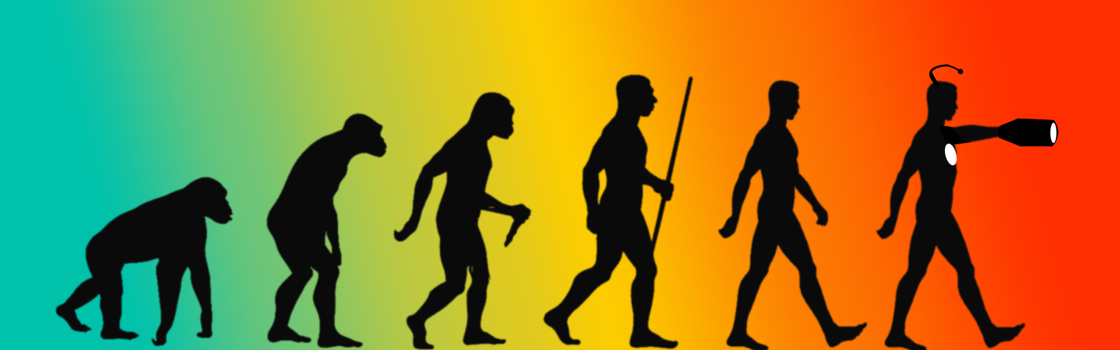
Why is chronology important?
Ignoring chronology would cause historians to write incorrect explanations. If they thought mobile phones existed in the medieval period, they would think messages travelled between individuals much faster than they did.
The past happened in time order. If a historian mixed up that order, it would turn history into fiction.
Historians often create timelines. This helps them to see clearly when events in the past took place
This Photo by Unknown Author is licensed under CC BY-NC

Slide 6
Look at the long-range timeline below – Draw a line from each development to the correct time- period. Then see if you can research and find a development to link to the time-periods that aren’t showing one
Primary School History
A brief history of human communication
4500BC- 1900BC Ancient Sumer 3300BC – 1700BC The Indus Valley Civilisation | Bronze Age (3000BC – 1500BC)
2686BC -525BC-Ancient Egypt 1600BC-1100BC- Shang Dynasty of Ancient China. 750BC-100BC – Ancient Greece | Iron Age (1500BC-27BC)
 | Roman Empire (27BC – AD 476)
 | Medieval period (AD 476 –AD 1500)
 | Early Modern period (AD 1500 – AD 1750)
 | Modern period (AD 1750- Present)
3000BC – picture based writing known as Cuneiform, first used.
1440s – printing press built by Gutenberg to print books.
1844 –Electric telegraph which sends messages in Morse code invented
1876
Alexander Graham Bell invents the telephone.
1983
First national mobile phone network launched in the UK.
1989
Development of the World Wide Web begins

Slide 7
Tasks
Write down one history topic you studied at primary school. Have a look back at the time-line, it might help you.
Underneath the topic (your answer to Q1)write down answers to the following questions:
Did it happen in the BC or AD part of the timeline?
Did it take place over one year, a decade (10years), a century (100years) or a millennium (1000 years)?
Which time period or age did it take place in?
3. Write a short explanation of why it is important to know when an event took place. Use your chosen history topic as an example

Slide 8
Now have a go at writing about your history or, the history of a friend, a pet or someone famous. Don’t forget to write in chronological order. Keep your work safe and bring it to your first history lesson in September
The birth of a baby brother or sister. | Something happens that makes you happy or angry. | You go to school for the first time. | You start a new hobby or join a new club. | You meet a best friend for the first time. | Something happens that changes your life for the better.
An important event happens in the world that you clearly remember. | Your sports team wins something. |  |  | Your earliest memory. | You move to a new house.
You learn to do something new. | You receive a present that you really love. | You learn to walk. | You go on a trip somewhere that you really enjoy. | You do something in your primary school that you are really proud of. | You go on a holiday that you really enjoyed.
Can’t think of anything?
Here are some suggestions

Slide 9
The History of Me!
I was born on __/__/____at
0 Years | 1 Year | 2 Years | 3 Years | 4 Years | 5 Years | 6 Years | 7 Years | 8 Years | 9 Years | 10 Years | 11 Years
In September I will begin learning at Shenley Academy!

Slide 10
The History of ……….

